Slide 1




22.02 Release
@RAPIDSai
https://github.com/rapidsai
https://rapids-goai.slack.com/join
https://rapids.ai
Notes:
https://rapids.ai/ https://github.com/rapidsai
https://docs.rapids.ai/overview

Slide 2
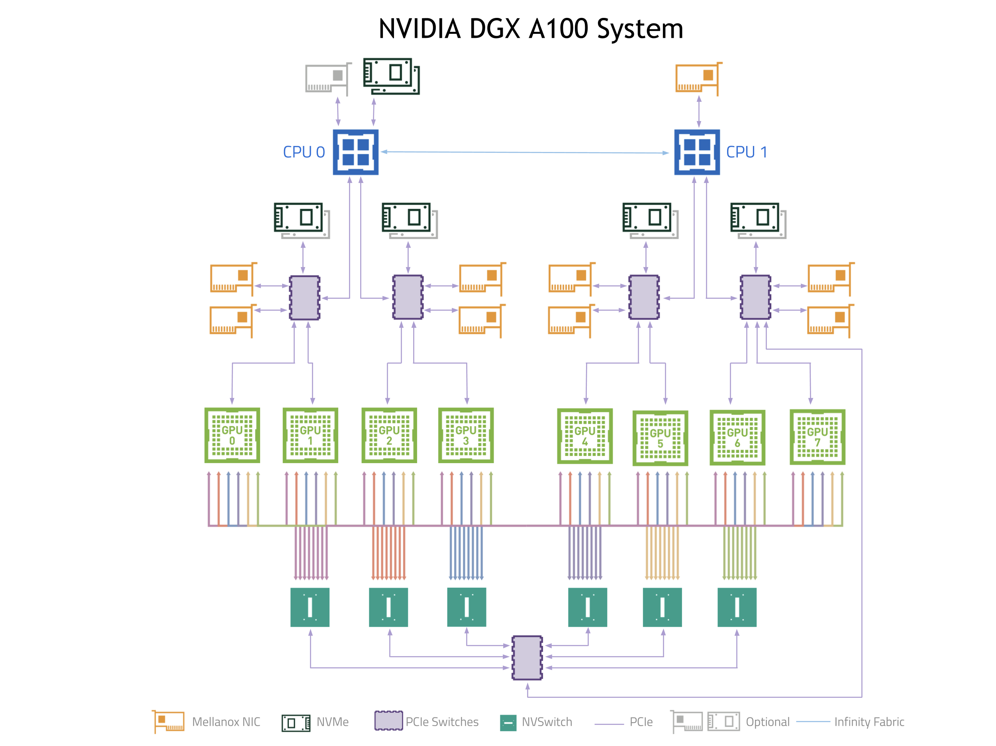
Why GPUs for Data Science?
Numerous hardware advantages
Thousands of cores with up to ~20 TeraFlops of general purpose compute performance
Up to 1.5 TB/s of memory bandwidth
Hardware interconnects for up to 600 GB/s bidirectional GPU <--> GPU bandwidth
Can scale up to 16x GPUs in a single node
Almost never run out of compute relative to memory bandwidth!

Slide 3
What is RAPIDS?
End-to-End GPU Accelerated Data Science
Data Preparation/ETL
Analytics/ML/Graph
Visualization
cuDF
GPU-accelerated ETL functions
Tracks Pandas and other common PyData APIs
Dask + UCX integration for scaling
RAPIDS ML
GPU-native cuML library, plus XGBoost, FIL, HPO, and more
cuGraph
GPU graph analytics, including TSP, PageRank, and more
cuxfilter
GPU-accelerated cross-filtering
pyViz integration
Plotly Dash, Bokeh, Datashader, HoloViews, hvPlot
Domain-Specific Libraries
CLX + Morpheus Cyber log processing + anomaly detection | cuSignal Signals processing | cuSpatial Spatial analytics
cuStreamz Streaming analytics | cuCIM Computer vision & image processing primitives | node-RAPIDS Bindings for node.js
...and more!

Slide 4
Overview of Changes: RAPIDS 22.02 Release
RAPIDS Added general support for SageMaker Studio Lab, support for Python 3.8 and 3.9, EOL support for Python 3.7; GPUDirect Storage (GDS) integration
RAPIDS+Dask Improved read parquet performance when using remote storage (optimizing data transfer and caching); Improved task fusion for Dataframe aggregations and when writing parquet files
cuDF Added support for decimal 128 in cuda python and Parquet reader and writer; added additional groupby method support for .corr() and .transform()
cuML Expanded support for gbdt model explainability with SHAP values
cuGraph added an initial release of a new Property Graph class; improved scale and performance (Louvain and Pagerank)
Dask-SQL Added support for multi GPU training and inference for cuML and XGBoost models directly within SQL statements; introduced basic support for Dask’s read filtering in CREATE TABLE WITH statements

Slide 5
cuDF Updates: Deep Dive
Release 22.02
Features added in 22.02
Added groupby method .corr() that will compute the Pearson correlation coefficient between dataframe columns
Added groupby method .transform() to apply aggregations to groups and broadcast the results to the group size
Support for decimal128 in Parquet reader and writer
Improved performance of partitioned Parquet writing
Support for decimal128 in cudf python
Planned Upcoming Features
String support in Numba UDFs
Optimize compaction operations w/ cuco
Unify cuDF UDF Interface

Slide 6
cuML Updates: Deep Dive
Release 22.02
Features added in 22.02
Add the ability to compute SHAP values for a wider range of general decision tree models (XGBoost, LightGBM models, and Random Forests with categorical variables from both Scikit-learn and cuML)
Planned Upcoming Features
New estimators like Kernel Density Estimation, Kernel Ridge Regression and others.
Performance optimizations.
RAPIDS-Triton backends additional features.
Increase reuse of CUDA/C++ primitives with RAFT library

Slide 7
cuGraph Updates: Deep Dive
Release 22.02
Features added in 22.02
Improved Louvain performance and scaling
Initial release of a new Property Graph class
Improved doctest automation
Scale testing: Pagerank and Louvain runs on 500+ GPUs
Planned Upcoming Features
Massive graph support, trillion edges
cuGraph integrated with DGL
Expanded Property Graph and new NetworkX Compatibility Module

Slide 8




Join the Conversation
GOOGLE GROUPS
DOCKER HUB
SLACK CHANNEL
STACK OVERFLOW
https://groups.google.com/forum/#!forum/rapidsai
https://hub.docker.com/r/rapidsai/rapidsai
https://rapids-goai.slack.com/join
https://stackoverflow.com/tags/rapids

Slide 9
THANK YOU
@RAPIDSai
Notes:
https://rapids.ai/ https://github.com/rapidsai
https://docs.rapids.ai/overview

